Slide 1

Airbnb Property Insights & Pricing Recommendation for Hosts in Bangkok

Slide 2
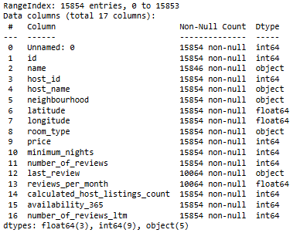
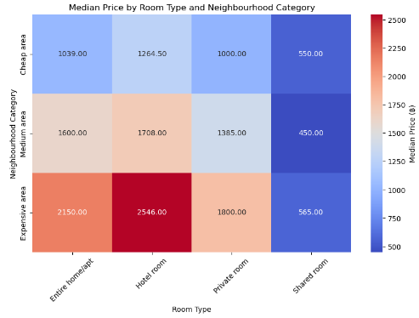
The Work Flow
Background
Problem Statement
Dataset & Library
Data Understanding & Cleaning
Airbnb hosts can set prices of their properties
Competitive price to optimize profits
"How can Airbnb hosts in Bangkok set optimal prices based on room type and neighborhood?"
Missing Value
‘name’
‘last_review’
‘review_per_month’
Duplicate Data
Anomaly Data
Summary & Recommendation
Analysis Data
Exploratory Data Analysis (EDA)
Airbnb property distribution by neighbourhoods
Total Airbnb property based on room type in neighbourhood category
Median rental price by neighbourhoods & room type
Price recommendation based on neighbourhood category & room type
Descriptive Statistics
Normality Test (D'Agostino and Pearson Test)

Slide 3
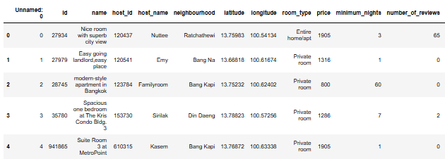
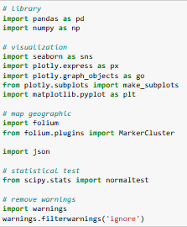
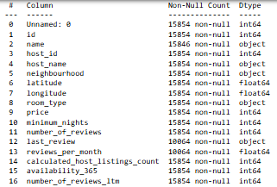
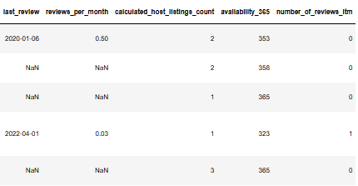
Background, Problem Statement, Dataset & Library
Background
Problem Statement
Airbnb hosts can set prices of their properties
Competitive price in Bangkok Airbnb property
"How can Airbnb hosts in Bangkok set optimal prices based on room type and neighborhood?"
Dataset & Library
Dataset with 17 columns and 15854 rows
The libraries

Slide 4
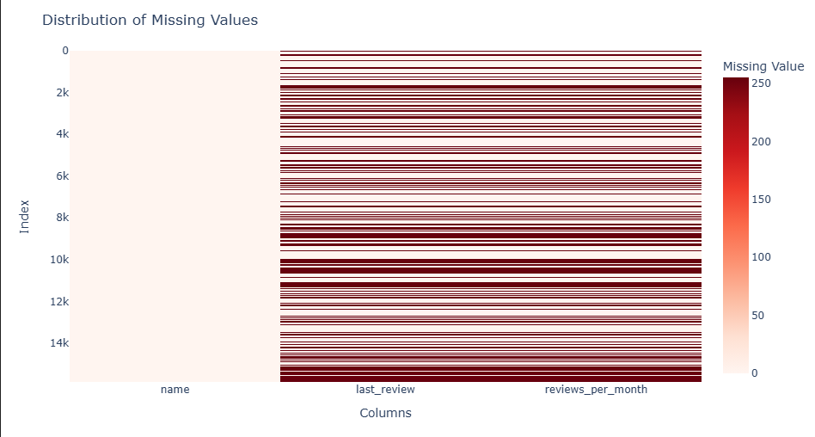
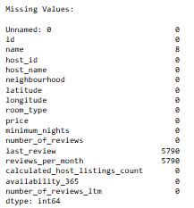
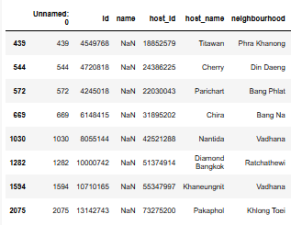
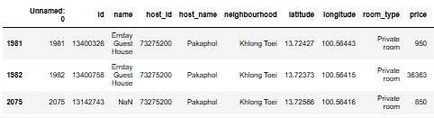
Data Understanding & Cleaning
Missing Value
Missing value in ‘name’ column
Change “NaN” into “No Name”
Based on research, “Pakaphol” has 3 listing in the same neighborhood.
All of those listings has a near latitude and longitude.
Therefore, in this case the ‘name’ filled by “Errday Guest House”.
Special case for ‘name’ in the ‘host_name’ = “Pakaphol”

Slide 5
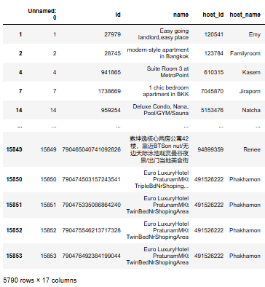
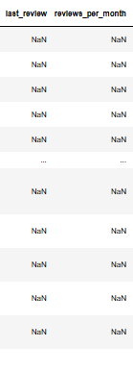
Data Understanding & Cleaning
Missing Value
Missing value in ‘last_review’ & ‘review_per_month”
always in the same index
Change “NaN” into 0

Slide 6
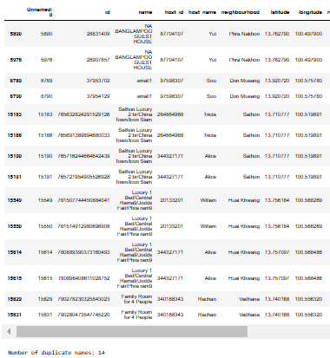

Data Understanding & Cleaning
Duplicate Data
Anomaly Data
Anomaly: room with 0 price
2 possibilities:
Input error
Promotion
To maintain the integrity of the analysis,
the price change will be replaced with the median value
The result of data cleaning
14 duplicate data → drop duplicate → 7 data remaining
cleaned_data_airbnb.csv
From 17 columns and 15854 rows
Into 17 columns and 15847 rows

Slide 7
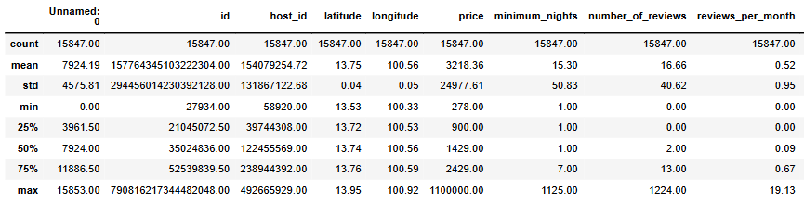
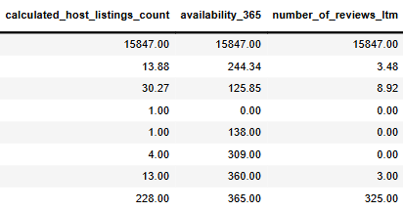
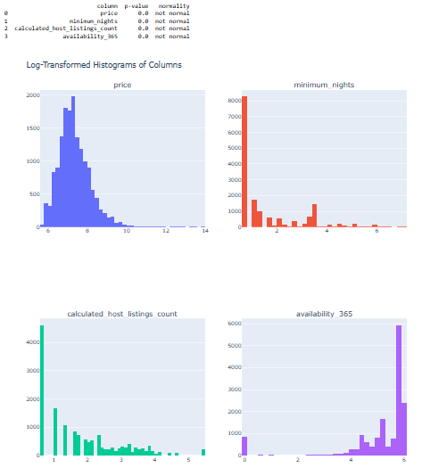
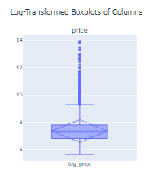
Exploratory Data Analysis (EDA)
Descriptive Statistics
Normality Test (D’Agostino & Pearson Test)
Right Skew Price Distribution
Most prices can be considered in the low to mid-range, with a few high prices being outliers.

Slide 8
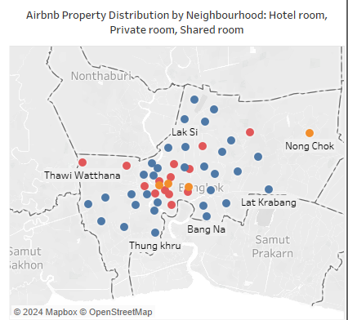
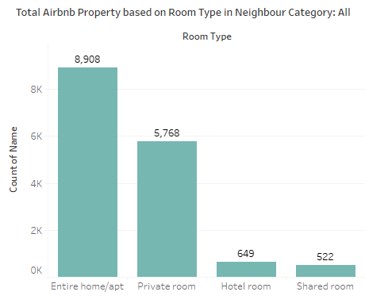
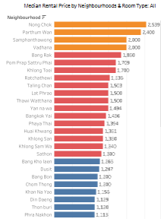

Analysis Data
Neighbourhoods Category based on Median Price Quartile
Cheap area : ฿ 656 – 1285
Medium area : ฿ 1285 – 1912
Expensive area : ฿ 1912 – 2539
Total: 15.847 Airbnb property in Bangkok

Slide 9
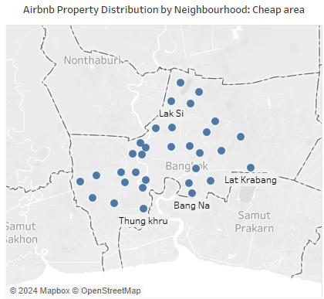
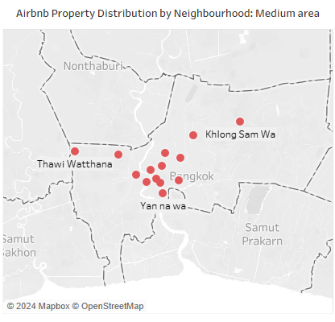
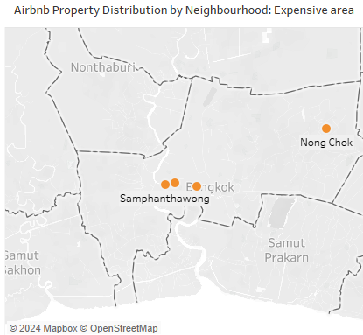
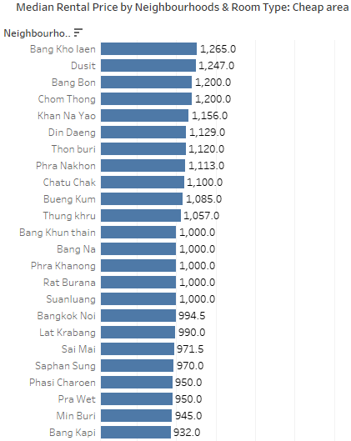
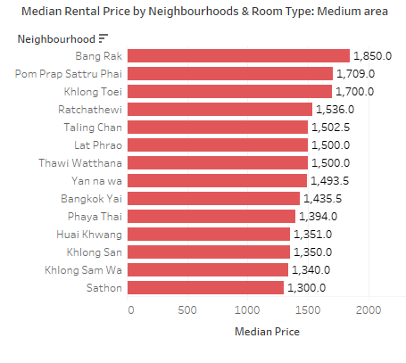
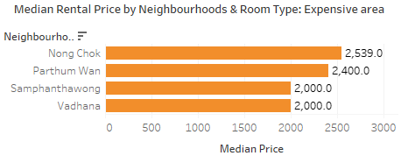
Analysis Data
4 neighbourhoods in Expensive Area
14 neighbourhoods in Medium Area
32 neighbourhoods in Cheap Area

Slide 10
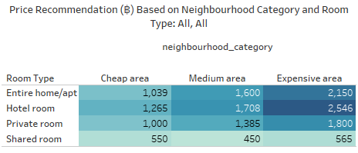
Summary & Recommendation
Problem Statement
"How can Airbnb hosts in Bangkok set optimal prices based on room type and neighborhood?"

